Slide 1

Guide to Operating Systems, 5th Edition
Unit 8
Popular Operating Systems
Notes:
Guide to Operating Systems, 5th Edition
Chapter 2
Popular Operating Systems

Slide 2
Objectives
After completing this chapter, you will be able to:
Describe early Microsoft operating systems and their characteristics
Identify the features of modern Microsoft operating systems
Identify the features and characteristics of UNIX and UNIX-like operating systems
Identify the features and characteristics of Mac OS and Mac OS X
Guide to Operating Systems, 5th Edition
Notes:
Objectives
After completing this chapter, you will be able to:
Describe early Microsoft operating systems and their characteristics
Identify the features of modern Microsoft operating systems
Identify the features and characteristics of UNIX and UNIX-like operating systems
Identify the features and characteristics of Mac OS and Mac OS X

Slide 3
Early Microsoft Operating Systems
MS-DOS and PC DOS
  MS-DOS was Microsoft’s original OS for the IBM PC
  PC DOS was customized and marketed by IBM
Windows 3.x
  First version of Windows using a graphical user interface (GUI)
  Ran slow and not well accepted at first
Windows 95
  Microsoft’s first true 32-bit OS
  Eliminated the 640 KB memory limit and 16-bit code
Guide to Operating Systems, 5th Edition
Notes:
Early Microsoft Operating Systems
MS-DOS and PC DOS
MS-DOS was Microsoft’s original OS for the IBM PC
PC DOS was customized and marketed by IBM
Windows 3.x
First version of Windows using a graphical user interface (GUI)
Ran slow and not well accepted at first
Windows 95
Microsoft’s first true 32-bit OS
Eliminated the 640 KB memory limit and 16-bit code

Slide 4
Windows 95
Introduced the GUI now called the “desktop”
Introduced Plug and Play (PnP)
  enables the OS to automatically detect newly installed hardware
Introduced ActiveX and the Component Object Model (COM)
  standardized way for objects, such as programs, files, computers, printers, etc… to communicate with each other
Guide to Operating Systems, 5th Edition
Notes:
Windows 95
Introduced the GUI now called the “desktop”
Introduced Plug and Play (PnP)
enables the OS to automatically detect newly installed hardware
Introduced ActiveX and the Component Object Model (COM)
standardized way for objects, such as programs, files, computers, printers, etc… to communicate with each other

Slide 5
Windows 95
Introduced “The Registry” – a database that stores OS information about hardware and software configuration
The Registry provides the following:
  OS configuration
  Service and device driver information and configuration
  Software and application parameters
  Hardware configuration
  Performance information
  Desktop configuration
Guide to Operating Systems, 5th Edition
Notes:
Windows 95
Introduced “The Registry” – a database that stores OS information about hardware and software configuration
The Registry provides the following:
OS configuration
Service and device driver information and configuration
Software and application parameters
Hardware configuration
Performance information
Desktop configuration

Slide 6
Windows 95
Multitasking – introduced a task supervisor that detects tasks that appear stuck and offers option to close those tasks without restarting
Networking functionality was extended and Internet Explorer web browser was integrated
Guide to Operating Systems, 5th Edition
Notes:
Windows 95
Multitasking – introduced a task supervisor that detects tasks that appear stuck and offers option to close those tasks without restarting
Networking functionality was extended and Internet Explorer web browser was integrated

Slide 7
Windows 98/Me
Windows 98 included the following changes:
  Expanded PnP support
  Automatic registry checks and repairs
  Advanced power management features
  Support for new hardware standards such as USB
  Improved cooperative multitasking for 16-bit apps
  Greater integration of Internet and networking features
  Extended multimedia support
  Expanded support for high-speed networking
  Ability to perform upgrades over the Internet
Guide to Operating Systems, 5th Edition
Notes:
Windows 98/Me
Windows 98 included the following changes:
Expanded PnP support
Automatic registry checks and repairs
Advanced power management features
Support for new hardware standards such as USB
Improved cooperative multitasking for 16-bit apps
Greater integration of Internet and networking features
Extended multimedia support
Expanded support for high-speed networking
Ability to perform upgrades over the Internet

Slide 8
Windows 98/Me
Windows Millennium Edition (Me)
  Developed for home computer users
  Implemented applications appealing to home users
    Playing music
    Storing family photos
    Playing games
    Accessing the Internet
  Provided better support for infrared devices
  Implemented the enhanced PnP standard called Universal Plug and Play (UPnP)
Guide to Operating Systems, 5th Edition
Notes:
Windows 98/Me
Windows Millennium Edition (Me)
Developed for home computer users
Implemented applications appealing to home users
Playing music
Storing family photos
Playing games
Accessing the Internet
Provided better support for infrared devices
Implemented the enhanced PnP standard called Universal Plug and Play (UPnP)

Slide 9
Windows NT
Windows New Technology (NT) – high-end OS to be used on very powerful computers
  OS kernel ran in privileged mode – protected it from problems created by a malfunctioning program or process
Offered in two versions: Windows NT Workstation and Windows NT Server
Supported high-speed network connectivity and remote access over telephone lines or Internet
Had a C2 top-secret security rating from the US government
Guide to Operating Systems, 5th Edition
Notes:
Windows NT
Windows New Technology (NT) – high-end OS to be used on very powerful computers
OS kernel ran in privileged mode – protected it from problems created by a malfunctioning program or process
Offered in two versions: Windows NT Workstation and Windows NT Server
Supported high-speed network connectivity and remote access over telephone lines or Internet
Had a C2 top-secret security rating from the US government

Slide 10
Windows 2000
Windows 2000 had a significant rewrite of the NT kernel and ran about 30% faster than NT
  Supported VPNs – private network that is like an encrypted tunnel through a larger network
Some new features:
  Active Directory – database that is used to store information about resources such as user accounts, computers, and printers
  Distributed network architecture – multiple servers could be designated as domain controllers, each containing a copy of Active Directory
Guide to Operating Systems, 5th Edition
Notes:
Windows 2000
Windows 2000 had a significant rewrite of the NT kernel and ran about 30% faster than NT
Supported VPNs – private network that is like an encrypted tunnel through a larger network
Some new features:
Active Directory – database that is used to store information about resources such as user accounts, computers, and printers
Distributed network architecture – multiple servers could be designated as domain controllers, each containing a copy of Active Directory

Slide 11
Windows 2000
Some new features (cont’d):
  Kerberos security – Kerberos is a security system that enables two parties on an open network to communicate without interception by an intruder
  IntelliMirror – intended to enable Windows 2000 clients to access the same desktop settings, applications, and data from wherever they accessed the network
  International language compatibility – supported more language and language capabilities than previous versions of Windows
Guide to Operating Systems, 5th Edition
Notes:
Windows 2000
Some new features (cont’d):
Kerberos security – Kerberos is a security system that enables two parties on an open network to communicate without interception by an intruder
IntelliMirror – intended to enable Windows 2000 clients to access the same desktop settings, applications, and data from wherever they accessed the network
International language compatibility – supported more language and language capabilities than previous versions of Windows

Slide 12
Windows 2000 Server and Windows 2000 Professional
Basic server and workstation (Professional) version to be used together on a server-based network
Windows 2000 Server supports up to 4 processors and offers more services (than Professional) such as:
  Handle unlimited numbers of users simultaneously
  Active Directory management
  Network management
  Web-based management services
  Network-wide security management
  Remote network access, network-wide communications services, and high-speed network connectivity
  Application services and network printer management
  Network printer management through Active Directory
Guide to Operating Systems, 5th Edition
Notes:
Windows 2000 Server and Windows 2000 Professional
Basic server and workstation (Professional) version to be used together on a server-based network
Windows 2000 Server supports up to 4 processors and offers more services (than Professional) such as:
Handle unlimited numbers of users simultaneously
Active Directory management
Network management
Web-based management services
Network-wide security management
Remote network access, network-wide communications services, and high-speed network connectivity
Application services and network printer management
Network printer management through Active Directory

Slide 13
Windows 2000 Server, Advanced Server, and Datacenter Server
Windows 2000 Server was divided into:
  Windows 2000 Server – provided a comprehensive set of server/Web services for up to 4 systems
  Windows 2000 Advanced Server – intended for high-end enterprise networks that require up to 8 processor servers, clustered serves, or both
    Clustering – technique in which two or more servers are linked to equally share the server processor load, storage, and other server resources
  Windows 2000 Datacenter – targeted for large database and data manipulation services
Guide to Operating Systems, 5th Edition
Notes:
Windows 2000 Server, Advanced Server, and Datacenter Server
Windows 2000 Server was divided into:
Windows 2000 Server – provided a comprehensive set of server/Web services for up to 4 systems
Windows 2000 Advanced Server – intended for high-end enterprise networks that require up to 8 processor servers, clustered serves, or both
Clustering – technique in which two or more servers are linked to equally share the server processor load, storage, and other server resources
Windows 2000 Datacenter – targeted for large database and data manipulation services

Slide 14
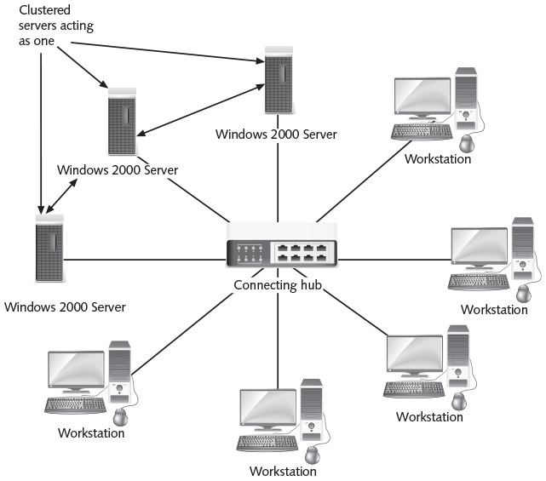
Windows 2000 Server, Advanced Server, and Datacenter Server
Figure 2-3 Server clustering
Guide to Operating Systems, 5th Edition
Notes:
Windows 2000 Server, Advanced Server, and Datacenter Server

Slide 15
Windows XP and Windows Server 2003
Windows XP (Windows Experience) – new desktop version with core elements of Windows 2000
Features:
  More capabilities for multimedia applications
  Better Internet security through a built-in firewall
  Remote Desktop – ability to control the computer over an Internet connection
  Requires an activation code that must be obtained by contacting Microsoft (ensures that software is not pirated)
Several versions include: Windows XP Home, XP Professional, XP Tablet PC, XP Media Center, and XP 62-Bit
Guide to Operating Systems, 5th Edition
Notes:
Windows XP and Windows Server 2003
Windows XP (Windows Experience) – new desktop version with core elements of Windows 2000
Features:
More capabilities for multimedia applications
Better Internet security through a built-in firewall
Remote Desktop – ability to control the computer over an Internet connection
Requires an activation code that must be obtained by contacting Microsoft (ensures that software is not pirated)
Several versions include: Windows XP Home, XP Professional, XP Tablet PC, XP Media Center, and XP 62-Bit

Slide 16
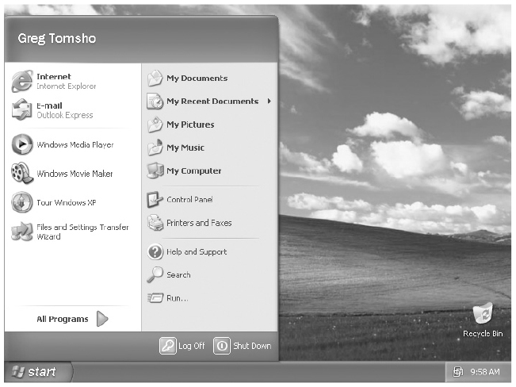
Windows XP and Windows Server 2003
Figure 2-4 The Windows XP desktop and Start menu
Guide to Operating Systems, 5th Edition
Notes:
Windows XP and Windows Server 2003

Slide 17
Windows XP and Windows Server 2003
Windows XP Professional – intended for office use
  Can be used as a small server for up to 10 users
  Can run on computers using up to 2 processors
Windows XP Home – meant as the next upgrade from Windows Me and is a scaled down version of Windows XP Professional
  Runs only on 32-bit single-processor computers
Program Compatibility Wizard – allows programs written for Windows 95 and earlier to run
Guide to Operating Systems, 5th Edition
Notes:
Windows XP and Windows Server 2003
Windows XP Professional – intended for office use
Can be used as a small server for up to 10 users
Can run on computers using up to 2 processors
Windows XP Home – meant as the next upgrade from Windows Me and is a scaled down version of Windows XP Professional
Runs only on 32-bit single-processor computers
Program Compatibility Wizard – allows programs written for Windows 95 and earlier to run

Slide 18
Windows Server 2003/R2
Windows Server 2003 comes in four versions:
  Standard Edition
  Enterprise Edition
  Datacenter Edition
  Web Edition
Some of the new features include:
  GUI interface used with Windows XP
  Faster network logon authentication through Active Directory
  New group policies that can be set to manage user workstations via Active Directory
Guide to Operating Systems, 5th Edition
Notes:
Windows Server 2003/R2
Windows Server 2003 comes in four versions:
Standard Edition
Enterprise Edition
Datacenter Edition
Web Edition
Some of the new features include:
GUI interface used with Windows XP
Faster network logon authentication through Active Directory
New group policies that can be set to manage user workstations via Active Directory

Slide 19
Windows Server 2003/R2
Some of the new features (cont’d):
  New tools for managing server resources
  Ability to run on 64-bit Itanium processors
  Remote server management through the Remote Desktop tool
  Enhanced ability for users to run programs on the server
  Runtime code for Windows .NET development environment to run applications through the Internet on all types of devices
Guide to Operating Systems, 5th Edition
Notes:
Windows Server 2003/R2
Some of the new features (cont’d):
New tools for managing server resources
Ability to run on 64-bit Itanium processors
Remote server management through the Remote Desktop tool
Enhanced ability for users to run programs on the server
Runtime code for Windows .NET development environment to run applications through the Internet on all types of devices

Slide 20
Windows Server 2003/R2
Windows Server 2003 Release 2 (R2) is an upgrade to Server 2003 with many new features
  Better performance
  Improved group policy management
  MMC 3.0 and the Print Management Console
  New server clustering capabilities
  Virtual server options
  Dynamic Systems Initiative
  Better identity and access management
  Better options for branch office servers
Guide to Operating Systems, 5th Edition
Notes:
Windows Server 2003/R2
Windows Server 2003 Release 2 (R2) is an upgrade to Server 2003 with many new features
Better performance
Improved group policy management
MMC 3.0 and the Print Management Console
New server clustering capabilities
Virtual server options
Dynamic Systems Initiative
Better identity and access management
Better options for branch office servers

Slide 21
Windows Server 2003/R2
Windows Server 2003 Release 2 (R2) new features (cont’d)
  DFS enhancements
  Subsystem for UNIX-based applications
  Improved storage management
Microsoft ended support for Windows Server 2003 in July 2015
  Urges companies to move to Windows Server 2008 or Windows Server 2012
Guide to Operating Systems, 5th Edition
Notes:
Windows Server 2003/R2
Windows Server 2003 Release 2 (R2) new features (cont’d)
DFS enhancements
Subsystem for UNIX-based applications
Improved storage management
Microsoft ended support for Windows Server 2003 in July 2015
Urges companies to move to Windows Server 2008 or Windows Server 2012

Slide 22
Modern Windows Operating Systems
Windows 7 and Windows Vista
  No longer receive mainstream support from Microsoft
  Extended support ends for Vista in April 2017 and in January 2020 for Windows 7
Guide to Operating Systems, 5th Edition
Notes:
Modern Windows Operating Systems
Windows 7 and Windows Vista
No longer receive mainstream support from Microsoft
Extended support ends for Vista in April 2017 and in January 2020 for Windows 7

Slide 23
Windows Vista/Windows 7
Microsoft Windows Vista (released Jan. ’07) – workstation operating system that followed XP
  Was not well received
Windows 7 was introduced in July ‘09
  Geared to make desktop computing more intuitive and reliable
  Has more built-in security features and requires less rebooting
    Example: when installing a software patch, no need to reboot right away
Guide to Operating Systems, 5th Edition
Notes:
Windows Vista/Windows 7
Microsoft Windows Vista (released Jan. ’07) – workstation operating system that followed XP
Was not well received
Windows 7 was introduced in July ‘09
Geared to make desktop computing more intuitive and reliable
Has more built-in security features and requires less rebooting
Example: when installing a software patch, no need to reboot right away

Slide 24
Windows Vista/Windows 7
Windows 7 was introduced in July ’09 (cont’d)
  One-third faster than Windows XP and Windows 2000
  New desktop presentation called Aero (Authentic, Energetic, Reflective, and Open)
  Reasons to upgrade: for greater speed, more productivity through the use of intuitive features, uniformity of the desktop, and greater security and reliability
Guide to Operating Systems, 5th Edition
Notes:
Windows Vista/Windows 7
Windows 7 was introduced in July ’09 (cont’d)
One-third faster than Windows XP and Windows 2000
New desktop presentation called Aero (Authentic, Energetic, Reflective, and Open)
Reasons to upgrade: for greater speed, more productivity through the use of intuitive features, uniformity of the desktop, and greater security and reliability

Slide 25
Windows Vista/Windows 7
Windows 7 implements many new features:
  Desktop and windows interface
  Libraries
  Folder resource sharing options
  Reliability features
  Security features
  User Account Protection
  Management options
Each of these are explained on the following slides
Guide to Operating Systems, 5th Edition
Notes:
Windows Vista/Windows 7
Windows 7 implements many new features:
Desktop and windows interface
Libraries
Folder resource sharing options
Reliability features
Security features
User Account Protection
Management options
Each of these are explained on the following slides

Slide 26
Windows Vista/Windows 7
Desktop and Windows Interface
  Introduces desktop “gadgets” – small applications for readily accessing information and tools (clock, calendar, etc…)
  Search box at the bottom of the Start menu enables fast searching for a specific document or file
  Renamed and reorganized Start Button options
  Control Panel still offered the Classic view, but also offered Category view to quickly address a specific task
Guide to Operating Systems, 5th Edition
Notes:
Windows Vista/Windows 7
Desktop and Windows Interface
Introduces desktop “gadgets” – small applications for readily accessing information and tools (clock, calendar, etc…)
Search box at the bottom of the Start menu enables fast searching for a specific document or file
Renamed and reorganized Start Button options
Control Panel still offered the Classic view, but also offered Category view to quickly address a specific task

Slide 27
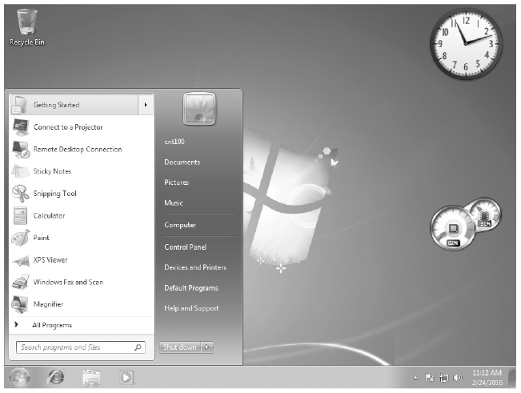
Windows Vista/Windows 7
Figure 2-5 The Windows 7 desktop and Start menu
Guide to Operating Systems, 5th Edition
Notes:
Windows Vista/Windows 7

Slide 28
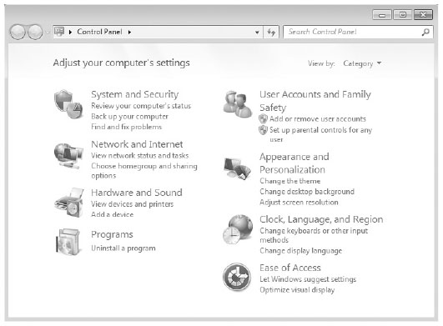
Windows Vista/Windows 7
Figure 2-6 Windows 7 Control Panel categories
Guide to Operating Systems, 5th Edition
Notes:
Windows Vista/Windows 7

Slide 29
Windows Vista/Windows 7
Libraries – organizes files from multiple locations on your computer and the network
  Not really a folder, but a dynamic folder housing files from one or more different locations
Folder Resource Sharing Options
  Sharing Wizard enables you to specify which users can access a folder
  Users can specify the use of a file on the basis of a personal or public profile
    Files not to be shared can be saved into a personal profile and files to be shared can be saved into a public profile
Guide to Operating Systems, 5th Edition
Notes:
Windows Vista/Windows 7
Libraries – organizes files from multiple locations on your computer and the network
Not really a folder, but a dynamic folder housing files from one or more different locations
Folder Resource Sharing Options
Sharing Wizard enables you to specify which users can access a folder
Users can specify the use of a file on the basis of a personal or public profile
Files not to be shared can be saved into a personal profile and files to be shared can be saved into a public profile

Slide 30
Windows Vista/Windows 7
Reliability Features:
  Startup Repair Tool – When a boot problem is detected, Windows 7 launches this tool which is designed to assess the problem and fix it
  Code to Prevent Interruptions – Microsoft strengthened OS code to prevent crashes/hangs
  Self-Diagnosis for Problems – built-in diagnostics for common hardware problems and memory problems
Guide to Operating Systems, 5th Edition
Notes:
Windows Vista/Windows 7
Reliability Features:
Startup Repair Tool – When a boot problem is detected, Windows 7 launches this tool which is designed to assess the problem and fix it
Code to Prevent Interruptions – Microsoft strengthened OS code to prevent crashes/hangs
Self-Diagnosis for Problems – built-in diagnostics for common hardware problems and memory problems

Slide 31
Windows Vista/Windows 7
Reliability Features (cont’d):
  Restart Manager – has the ability to determine which running processes are affected by an update or patch and can restart an affected service without rebooting the computer
  Service Failure Recovery – OS can detect when a service has failed and attempt to restart it
Guide to Operating Systems, 5th Edition
Notes:
Windows Vista/Windows 7
Reliability Features (cont’d):
Restart Manager – has the ability to determine which running processes are affected by an update or patch and can restart an affected service without rebooting the computer
Service Failure Recovery – OS can detect when a service has failed and attempt to restart it

Slide 32
Windows Vista/Windows 7
Security Features:
  A more comprehensive firewall
  User Account Protection (UAP)
  Built-in security software to find and eliminate malicious software
  Status information
Guide to Operating Systems, 5th Edition
Notes:
Windows Vista/Windows 7
Security Features:
A more comprehensive firewall
User Account Protection (UAP)
Built-in security software to find and eliminate malicious software
Status information

Slide 33
Windows Vista/Windows 7
Windows 7 Management Options – Windows 7 comes with more group policy settings
  Means computers can be standardized for easier use
  Windows Resource Protection (WRP) – used to make it more difficult to change system settings and files, such as the registry
  Windows 7 brings back the Administrative Tools menu Some of the tools include:
    Computer Management
    Reliability and Performance Monitor
    Task Scheduler
    Event Viewer
Guide to Operating Systems, 5th Edition
Notes:
Windows Vista/Windows 7
Windows 7 Management Options – Windows 7 comes with more group policy settings
Means computers can be standardized for easier use
Windows Resource Protection (WRP) – used to make it more difficult to change system settings and files, such as the registry
Windows 7 brings back the Administrative Tools menu Some of the tools include:
Computer Management
Reliability and Performance Monitor
Task Scheduler
Event Viewer

Slide 34
Windows Server 2008/R2
Windows Server 2008/R2
  Shares the same code base and same new features as Windows Vista/7
The following additional features of Windows Server 2008/R2 are covered on the following slides:
  Active Directory
  Failover Clustering
  Hyper-V
  Self-Healing NTFS
  Server Core
  Server Manager
Guide to Operating Systems, 5th Edition
Notes:
Windows Server 2008/R2
Windows Server 2008/R2
Shares the same code base and same new features as Windows Vista/7
The following additional features of Windows Server 2008/R2 are covered on the following slides:
Active Directory
Failover Clustering
Hyper-V
Self-Healing NTFS
Server Core
Server Manager

Slide 35
Windows Server 2008/R2
Active Directory – Read-only domain controller (RODC) was implemented so that hackers cannot make changes at remote locations to be replicated to the main domain controller at corporate headquarters
Failover Clustering – Windows Server 2008 Enterprise and Datacenter editions have a cluster validation wizard that runs validation tests on the servers to be clustered
Hyper-V – allows the server to run multiple independent operating systems at the same time
Guide to Operating Systems, 5th Edition
Notes:
Windows Server 2008/R2
Active Directory – Read-only domain controller (RODC) was implemented so that hackers cannot make changes at remote locations to be replicated to the main domain controller at corporate headquarters
Failover Clustering – Windows Server 2008 Enterprise and Datacenter editions have a cluster validation wizard that runs validation tests on the servers to be clustered
Hyper-V – allows the server to run multiple independent operating systems at the same time

Slide 36
Windows Server 2008/R2
Self-Healing NTFS – Chkdsk.exe utility runs in the background to correct hard disk problems
  In the past, the volume (system) had to be taken down in order to run chkdsk.exe
Server Core – bare-bones installation that is meant to reduce hacker attacks to the OS
Server Manager – combines and replaces the Manage Your Server, Configure Your Server, and the Security Configuration Wizard tools found in Windows Server 2003
Guide to Operating Systems, 5th Edition
Notes:
Windows Server 2008/R2
Self-Healing NTFS – Chkdsk.exe utility runs in the background to correct hard disk problems
In the past, the volume (system) had to be taken down in order to run chkdsk.exe
Server Core – bare-bones installation that is meant to reduce hacker attacks to the OS
Server Manager – combines and replaces the Manage Your Server, Configure Your Server, and the Security Configuration Wizard tools found in Windows Server 2003

Slide 37
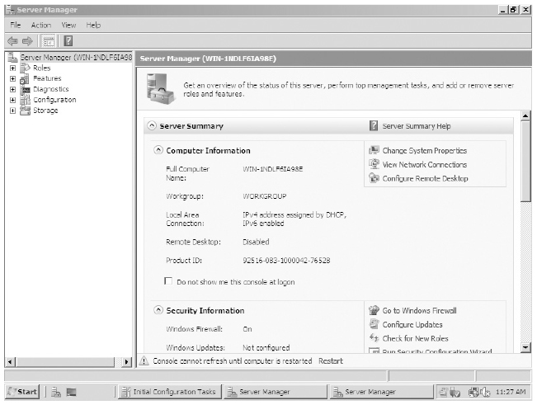
Windows Server 2008/R2
Figure 2-8 Windows Server 2008 Server Manager
Guide to Operating Systems, 5th Edition
Notes:
Windows Server 2008/R2

Slide 38
Windows Server 2008/R2
Windows Server 2008/R2 supports up to 64 physical processors and up to 64 TB of RAM
New, updated, and enhanced features of R2:
  Integration with Windows 7
  File services management
  Scalability
  Reliability
  Virtualization
  Web platform updates
Guide to Operating Systems, 5th Edition
Notes:
Windows Server 2008/R2
Windows Server 2008/R2 supports up to 64 physical processors and up to 64 TB of RAM
New, updated, and enhanced features of R2:
Integration with Windows 7
File services management
Scalability
Reliability
Virtualization
Web platform updates

Slide 39
Windows Server 2008/R2
Integration with Windows 7
  Microsoft introduced DirectAccess to provide the functionality of a VPN
  BranchCache – feature allows the remote network to cache frequently accessed applications and information to reduce the traffic over the network link
File Services Management
  Windows File Classification Infrastructure (FCI) provides the information needed to manage data
    If data contains sensitive information, FCI may move this information to a more secure server and even encrypt it
Guide to Operating Systems, 5th Edition
Notes:
Windows Server 2008/R2
Integration with Windows 7
Microsoft introduced DirectAccess to provide the functionality of a VPN
BranchCache – feature allows the remote network to cache frequently accessed applications and information to reduce the traffic over the network link
File Services Management
Windows File Classification Infrastructure (FCI) provides the information needed to manage data
If data contains sensitive information, FCI may move this information to a more secure server and even encrypt it

Slide 40
Windows Server 2008/R2
Scalability – includes components to help reduce the number of physical servers
Reliability – Windows Hardware Error Architecture (WHEA) supports memory and cache error recovery
  Administrators can add additional memory, processors, and I/O resources to a server without taking the server down
Virtualization – provides Hyper-V for server virtualization
  Hyper-V Management Console and System Center Virtual Machine Manager 2008 are two new enhancements
Guide to Operating Systems, 5th Edition
Notes:
Windows Server 2008/R2
Scalability – includes components to help reduce the number of physical servers
Reliability – Windows Hardware Error Architecture (WHEA) supports memory and cache error recovery
Administrators can add additional memory, processors, and I/O resources to a server without taking the server down
Virtualization – provides Hyper-V for server virtualization
Hyper-V Management Console and System Center Virtual Machine Manager 2008 are two new enhancements

Slide 41
Windows Server 2008/R2
Web Platform Updates
  IIS 7.5 provides centralized Web management, more reliability, and improved security
  New administration console called IIS 7.5 Manager – allows for both local and remote administration
  IIS 7.5 has a modular architecture so that the server administrator can load just the modules needed for the specific type of Web services being offered
Guide to Operating Systems, 5th Edition
Notes:
Windows Server 2008/R2
Web Platform Updates
IIS 7.5 provides centralized Web management, more reliability, and improved security
New administration console called IIS 7.5 Manager – allows for both local and remote administration
IIS 7.5 has a modular architecture so that the server administrator can load just the modules needed for the specific type of Web services being offered

Slide 42
Windows 8/8.1
Windows 8 was released Oct ‘12
  Windows 8.1 was released in Oct ’13
In Windows 8, the Start button was replaced by the Start screen
  Containing live tiles you can press or click to start applications or access the desktop
New and improved features include:
  User interface changes, storage enhancements, security enhancements, Client Hyper-V, Integration with online services
Guide to Operating Systems, 5th Edition
Notes:
Windows 8/8.1
Windows 8 was released Oct ‘12
Windows 8.1 was released in Oct ’13
In Windows 8, the Start button was replaced by the Start screen
Containing live tiles you can press or click to start applications or access the desktop
New and improved features include:
User interface changes, storage enhancements, security enhancements, Client Hyper-V, Integration with online services

Slide 43
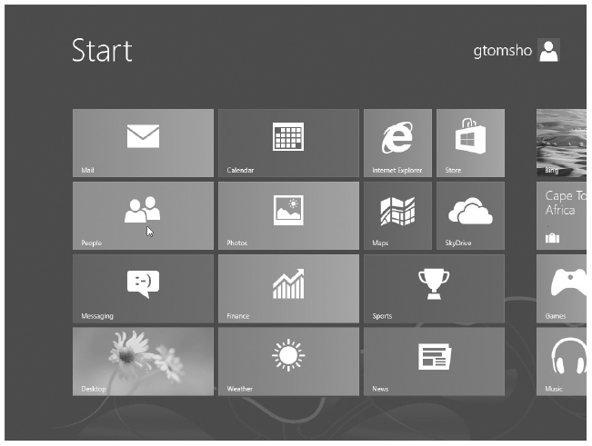
Windows 8/8.1
Figure 2-9 Windows 8 Start screen
Guide to Operating Systems, 5th Edition
Notes:
Windows 8/8.1

Slide 44
Windows 8/8.1
User Interface
  Windows Explorer is renamed File Explorer
  Task Manager makes it easier to see what processes are running and what resources are being used
  Start button came back in a reduced form in Windows 8.1
    Right-clicking it gives administrators and power users quick access to frequently used administrator tools
Guide to Operating Systems, 5th Edition
Notes:
Windows 8/8.1
User Interface
Windows Explorer is renamed File Explorer
Task Manager makes it easier to see what processes are running and what resources are being used
Start button came back in a reduced form in Windows 8.1
Right-clicking it gives administrators and power users quick access to frequently used administrator tools

Slide 45
Windows 8/8.1
Storage Enhancements
  Storage Spaces – storage management and configuration tool
  Ability to mount CD and DVD images with a double-click on an ISO file
Security Enhancements
  Add the option to sign in with a Microsoft online account rather than using a local user account
  Ability to sign-in using a PIN or a picture password
  Adds parental control options
Guide to Operating Systems, 5th Edition
Notes:
Windows 8/8.1
Storage Enhancements
Storage Spaces – storage management and configuration tool
Ability to mount CD and DVD images with a double-click on an ISO file
Security Enhancements
Add the option to sign in with a Microsoft online account rather than using a local user account
Ability to sign-in using a PIN or a picture password
Adds parental control options

Slide 46
Windows 8/8.1
Client Hyper-V
  Uses the same virtualization technology found on Windows Server
  Allows you to upgrade to latest Windows version and be able to run older version of Windows in a virtual machine (VM)
Online Services
  Client necessary to access Microsoft’s OneDrive cloud storage service is built in
  Windows Store apps can be downloaded
Guide to Operating Systems, 5th Edition
Notes:
Windows 8/8.1
Client Hyper-V
Uses the same virtualization technology found on Windows Server
Allows you to upgrade to latest Windows version and be able to run older version of Windows in a virtual machine (VM)
Online Services
Client necessary to access Microsoft’s OneDrive cloud storage service is built in
Windows Store apps can be downloaded

Slide 47
Windows Server 2012/R2
Comes in the following editions:
  Standard - suitable for most mid-sized companies
  Datacenter – Designed for organization that rely heavily on Hyper-V virtualization
  Essentials – aimed at small businesses with 25 or fewer users
  Foundation – entry-level edition
Maintains all the core technologies used in Windows Server 2008 with some enhancements
Guide to Operating Systems, 5th Edition
Notes:
Windows Server 2012/R2
Comes in the following editions:
Standard - suitable for most mid-sized companies
Datacenter – Designed for organization that rely heavily on Hyper-V virtualization
Essentials – aimed at small businesses with 25 or fewer users
Foundation – entry-level edition
Maintains all the core technologies used in Windows Server 2008 with some enhancements

Slide 48
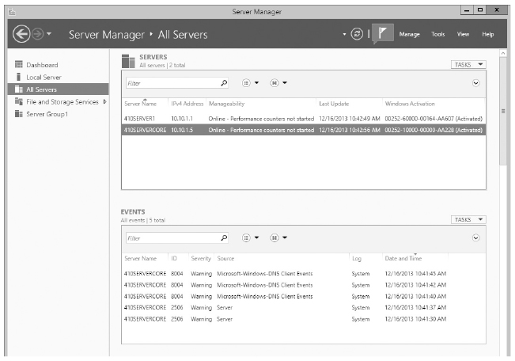
Windows Server 2012/R2
Server Manager
  Updated to allow administrators to manage servers from a single management console
Figure 2-11 Windows Server Manager in Windows Server 2012/R2
Guide to Operating Systems, 5th Edition
Notes:
Windows Server 2012/R2
Server Manager
Updated to allow administrators to manage servers from a single management console

Slide 49
Windows Server 2012/R2
NTFS File System
  NTFS has added many new features, including disk quotas, built-in file compression and encryption, BitLocker drive encryption, and other performance and reliability improvements
Active Directory
  Features added include an easy-to-use Recycle Bin to restore deleted objects, and a user interface to create password policies
Guide to Operating Systems, 5th Edition
Notes:
Windows Server 2012/R2
NTFS File System
NTFS has added many new features, including disk quotas, built-in file compression and encryption, BitLocker drive encryption, and other performance and reliability improvements
Active Directory
Features added include an easy-to-use Recycle Bin to restore deleted objects, and a user interface to create password policies

Slide 50
Windows Server 2012/R2
New Features in Windows Server 2012/R2
  Server Core
  Minimal Server Interface
  Hyper-V 3.0
  PowerShell 4.0
  Storage Spaces
  Resilient File System (ReFS)
  Dynamic Access Control (DAC)
Guide to Operating Systems, 5th Edition
Notes:
Windows Server 2012/R2
New Features in Windows Server 2012/R2
Server Core
Minimal Server Interface
Hyper-V 3.0
PowerShell 4.0
Storage Spaces
Resilient File System (ReFS)
Dynamic Access Control (DAC)

Slide 51
Windows 10
Windows 10 was released in July 2015
  Builds on the successful features of Windows 8/8.1
Some key features include:
  Virtual desktops
  Return of the Start button
  Microsoft Edge Web browser
  Cortana digital assistant
  Quick access
  Universal application architecture
  Sign-in options
Guide to Operating Systems, 5th Edition
Notes:
Windows 10
Windows 10 was released in July 2015
Builds on the successful features of Windows 8/8.1
Some key features include:
Virtual desktops
Return of the Start button
Microsoft Edge Web browser
Cortana digital assistant
Quick access
Universal application architecture
Sign-in options

Slide 52
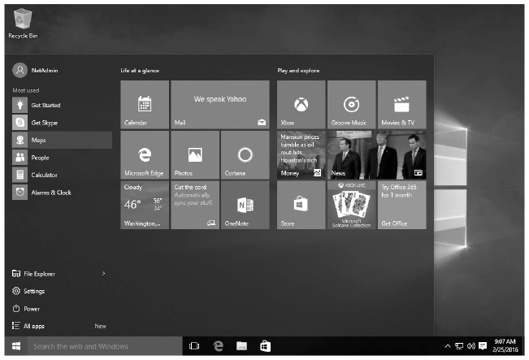
Windows 10
Figure 2-13 Windows 10 Start button
Guide to Operating Systems, 5th Edition
Notes:
Windows 10

Slide 53
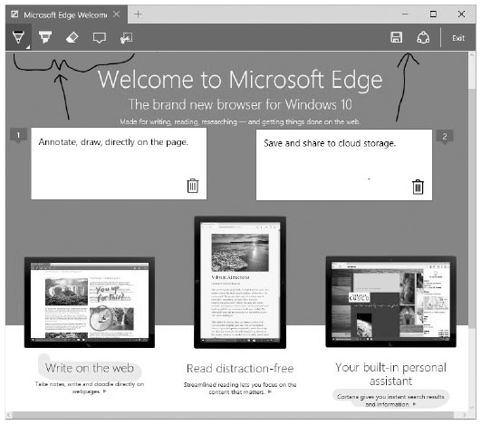
Windows 10
Figure 2-14 Microsoft Edge Web browser
Guide to Operating Systems, 5th Edition
Notes:
Windows 10

Slide 54
Windows Server 2016
Windows Server 2016 comes with the Windows 10 user interface and builds upon features of Windows Server 2012/R2
  Due to be released in the fall of 2016
A few highlights:
  Hyper-V
  Nano Server
  Failover clusters
  Windows Containers
Guide to Operating Systems, 5th Edition
Notes:
Windows Server 2016
Windows Server 2016 comes with the Windows 10 user interface and builds upon features of Windows Server 2012/R2
Due to be released in the fall of 2016
A few highlights:
Hyper-V
Nano Server
Failover clusters
Windows Containers

Slide 55
UNIX and UNIX-like Operating Systems
The UNIX OS comes in many different formats
  Of all OSs covered in this book, it is the oldest, most diverse, and most complicated
AT&T developed UNIX but never licensed the kernel
  There are many versions with many diverse utilities
Two main design standards:
  Berkeley Software Distribution (BSD)
  System V Release 4 (SVR4) – Linux is an example
This book uses Linux for its UNIX examples
Guide to Operating Systems, 5th Edition
Notes:
UNIX and UNIX-like Operating Systems
The UNIX OS comes in many different formats
Of all OSs covered in this book, it is the oldest, most diverse, and most complicated
AT&T developed UNIX but never licensed the kernel
There are many versions with many diverse utilities
Two main design standards:
Berkeley Software Distribution (BSD)
System V Release 4 (SVR4) – Linux is an example
This book uses Linux for its UNIX examples

Slide 56
UNIX and UNIX-like Operating Systems
Runs on almost any hardware
UNIX is a true multitasking, multiuser operating system
Most UNIX versions come with different “shells” or user interfaces and it is up to the user to pick the shell they wish to use
  Most shells function in the same way
  Most popular are the Bourne shell (sh) and Bourne Again shell (bash)
Some UNIX versions provide you with a GUI
  X Window is the most popular
Guide to Operating Systems, 5th Edition
Notes:
UNIX and UNIX-like Operating Systems
Runs on almost any hardware
UNIX is a true multitasking, multiuser operating system
Most UNIX versions come with different “shells” or user interfaces and it is up to the user to pick the shell they wish to use
Most shells function in the same way
Most popular are the Bourne shell (sh) and Bourne Again shell (bash)
Some UNIX versions provide you with a GUI
X Window is the most popular

Slide 57
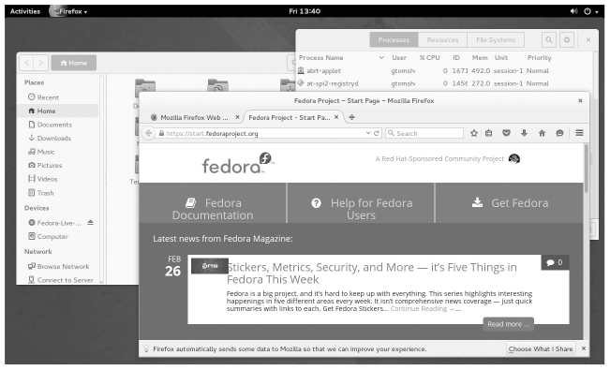
UNIX and UNIX-like Operating Systems
Figure 2-15 The GNOME desktop in Fedora
Guide to Operating Systems, 5th Edition
Notes:
UNIX and UNIX-like Operating Systems

Slide 58
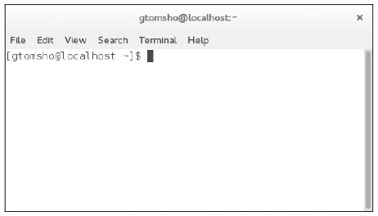
UNIX and UNIX-like Operating Systems
Figure 2-16 A terminal window in Linux
Guide to Operating Systems, 5th Edition
Notes:
UNIX and UNIX-like Operating Systems

Slide 59
UNIX and UNIX-like Operating Systems
Standard UNIX operating system does not provide many network functions
  Most of these functions are provided by add-ons
UNIX security model made it the early system of choice for Internet server and firewall services
UNIX computers are often used as database or applications servers and for industrial control applications
Most versions come with a line editor that is used to create text one line at a time
Guide to Operating Systems, 5th Edition
Notes:
UNIX and UNIX-like Operating Systems
Standard UNIX operating system does not provide many network functions
Most of these functions are provided by add-ons
UNIX security model made it the early system of choice for Internet server and firewall services
UNIX computers are often used as database or applications servers and for industrial control applications
Most versions come with a line editor that is used to create text one line at a time

Slide 60
Mac OS
Macintosh computers revolutionized the world of OSs with an all-graphical user interface and shell
Mac OS X is built on Darwin UNIX, which is a distribution of the BSD UNIX version
The hardware architecture needed to run Mac OS is very dependent on the version of the OS
  If you are running the newest generation of hardware, you are required to run Mac OS X
Guide to Operating Systems, 5th Edition
Notes:
Mac OS
Macintosh computers revolutionized the world of OSs with an all-graphical user interface and shell
Mac OS X is built on Darwin UNIX, which is a distribution of the BSD UNIX version
The hardware architecture needed to run Mac OS is very dependent on the version of the OS
If you are running the newest generation of hardware, you are required to run Mac OS X

Slide 61
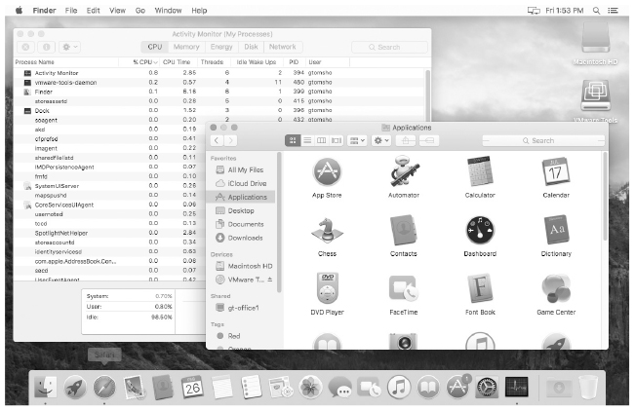
Mac OS
Figure 2-17 The Mac OS X El Capitan desktop
Guide to Operating Systems, 5th Edition
Notes:
Mac OS

Slide 62
Mac OS
Peer-to-peer networking has always been a standard feature of MAC OS
  Older versions used the AppleTalk protocol
MAC OS was always meant to be a desktop operating system
  No extended security features to keep users from getting access to files on local computers
MAC OS has been known for its support of graphics, video, and sound capabilities
  Graphical artists prefer MAC font management and Color Sync color matching technologies
Guide to Operating Systems, 5th Edition
Notes:
Mac OS
Peer-to-peer networking has always been a standard feature of MAC OS
Older versions used the AppleTalk protocol
MAC OS was always meant to be a desktop operating system
No extended security features to keep users from getting access to files on local computers
MAC OS has been known for its support of graphics, video, and sound capabilities
Graphical artists prefer MAC font management and Color Sync color matching technologies

Slide 63
Mac OS X
Mac OS X (version 10) – introduced the “Aqua” interface
  Some previous programs and utilities were replaced
  Is configured so that different users can access the OS in their own workspaces, without affecting other users
  Many windows in Mac OS X now can be customized so their contents appear in columns
  Internet connectivity is enhanced in Mac OS X through the Internet Connect tool
Guide to Operating Systems, 5th Edition
Notes:
Mac OS X
Mac OS X (version 10) – introduced the “Aqua” interface
Some previous programs and utilities were replaced
Is configured so that different users can access the OS in their own workspaces, without affecting other users
Many windows in Mac OS X now can be customized so their contents appear in columns
Internet connectivity is enhanced in Mac OS X through the Internet Connect tool

Slide 64
Mac OS X
Different Mac OS X releases:
  Mac OS X 10.6 Snow Leopard
  Mac OS X 10.7 Lion
  Mac OS X 10.8 Mountain Lion
  Mac OS X 10.9 Mavericks
  Mac OS X 10.10 Yosemite
Guide to Operating Systems, 5th Edition
Notes:
Mac OS X
Different Mac OS X releases:
Mac OS X 10.6 Snow Leopard
Mac OS X 10.7 Lion
Mac OS X 10.8 Mountain Lion
Mac OS X 10.9 Mavericks
Mac OS X 10.10 Yosemite

Slide 65
Mac OS X 10.11 El Capitan
The current release that started shipping in Sept 2015
Features and improvements:
  Split View – lets you work in two applications at the same time
  Spotlight search app was updated
  Pinned Sites – lets you easily recall your favorite Web sites
  Some new swipe gestures were added
  Metal for Mac – a set of 3D development tools for designing games and other 3D apps
Guide to Operating Systems, 5th Edition
Notes:
Mac OS X 10.11 El Capitan
The current release that started shipping in Sept 2015
Features and improvements:
Split View – lets you work in two applications at the same time
Spotlight search app was updated
Pinned Sites – lets you easily recall your favorite Web sites
Some new swipe gestures were added
Metal for Mac – a set of 3D development tools for designing games and other 3D apps

Slide 66
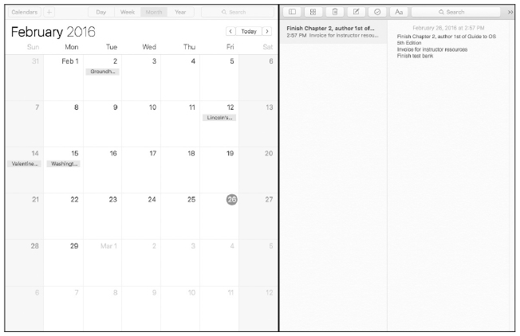
Mac OS X 10.11 El Capitan
Figure 2-18 Split View on Mac OS X El Capitan
Guide to Operating Systems, 5th Edition
Notes:
Mac OS X 10.11 El Capitan

Slide 67
Summary
Early computer operating systems were primitive compared to current computer operating systems but were significant during their time and moved us toward a desktop computing environment
Windows, Macintosh, and Linux/UNIX are popular current operating systems, with new releases being announced on a regular basis
Guide to Operating Systems, 5th Edition
Notes:
Summary
Early computer operating systems were primitive compared to current computer operating systems but were significant during their time and moved us toward a desktop computing environment
Windows, Macintosh, and Linux/UNIX are popular current operating systems, with new releases being announced on a regular basis

Slide 68
Summary
Server operating systems have evolved to allow clustering, virtual servers, self-healing NTFS, a storage manager for SANS, single sign-on, network management, and security features
Mac OS X is built on Darwin UNIX, which is a distribution of the BSD UNIX version
  Mac OS X 10.11 El Capitan is the latest Mac OS X release
Guide to Operating Systems, 5th Edition
Notes:
Summary
Server operating systems have evolved to allow clustering, virtual servers, self-healing NTFS, a storage manager for SANS, single sign-on, network management, and security features
Mac OS X is built on Darwin UNIX, which is a distribution of the BSD UNIX version
Mac OS X 10.11 El Capitan is the latest Mac OS X release

